Slide 1
Figure 1. Biostimulation of three different potato genotypes treated with P. oligandrum. (A-J) Boxplots of biostimulation of potato plants treated with P. oligandrum (blue boxplots) or untreated controls (red boxplots), in the three different genotypes Kuras, Desirée, King Edward, in greenhouse bioassays. (A-C) Plant height of the longest shoot in cm. (D-F) Fresh weight of the shoots in grams. (G-J) Fresh weight of roots in logarithmic transformed weight in grams. NS p >0.05, * p <0.05,*** p <0.001 The total number of plants treated, or controls were n=6 per experiment per genotype. The experiment was repeated 3 times independently. (K) Boxplot of the cv. Kuras potato plant height of the longest shoot at the end of the cropping season in a small-scale field trial. The red boxplot represents untreated control plants, and the blue boxplot P. oligandrum treated plants. Significant difference (p < 0.05) is indicated with an asterisk. The total number of plants used per treatment in the field trial was n=12.

Slide 2
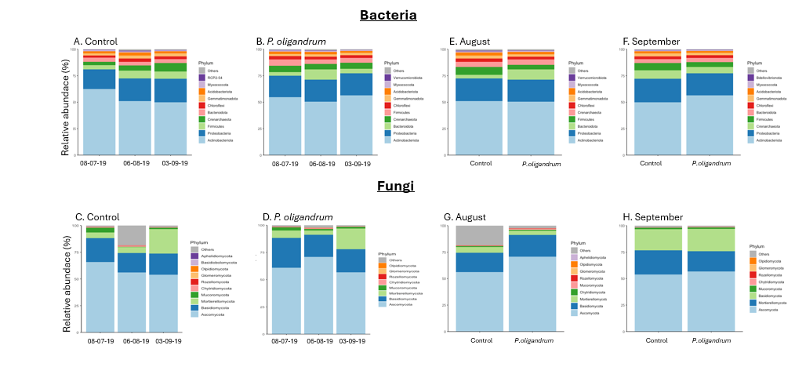
Figure 2. The top 10 most abundant phyla in the rhizosphere microbiome of cv. Kuras potato plants in a small-scale field trial. (A) and (C) the relative abundance of bacterial and fungal phyla in the untreated control plants. (B) and (D) the relative abundance of bacterial and fungal phyla in P. oligandrum treated plants. The three sampling timepoints i.e. in July (08-07-19) where no treatments had been conducted, August (06-08-19) and September (03-09-19), where treatment had been conducted, are presented on the x-axis. (E-H) Comparison of the relative abundance of top 10 bacterial and fungal phyla between untreated control plants and P. oligandrum treated plants in the rhizosphere microbiome of cv. Kuras potato plants in a small-scale field trial. (E) and (G) at the August timepoint and (F) and (H) in September.

Slide 3
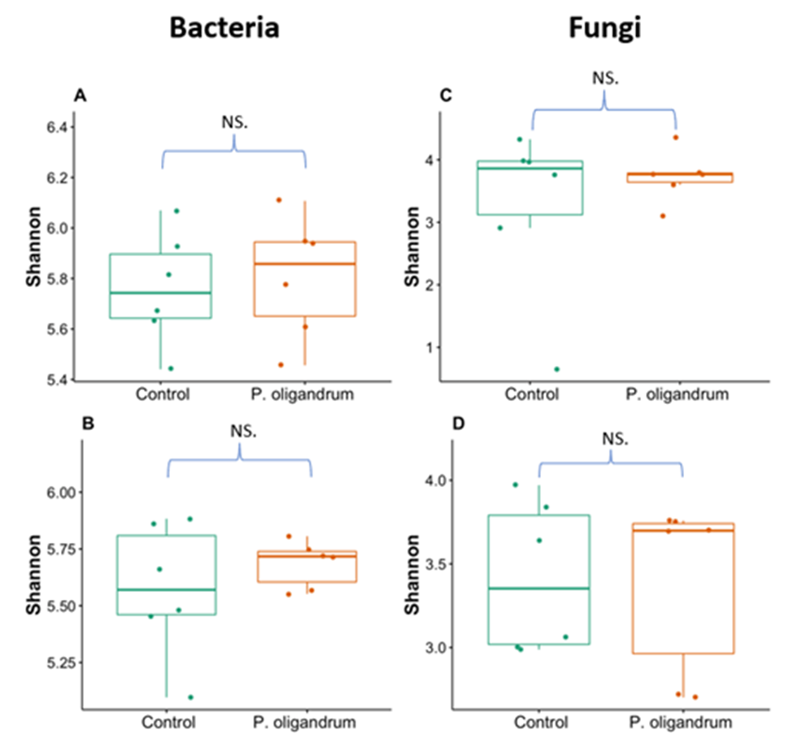
Figure 3. Alpha diversity shown as Shannon index between untreated control plants or plants treated with P. oligandrum in the rhizosphere microbiome of cv. Kuras potato plants in a small-scale field trial. (A) Bacteria samples at the August timepoint. (B) Bacteria samples at the September timepoint. (C) Fungal samples at the August timepoint. (D) Fungal samples at the September timepoint.

Slide 4
Bacteria
A. Control
B. P. oligandrum
E. August
F. September
*
*
*
Fungi
C. Control
D. P.oligandrum
G. August
H. September
*
Figure 4. Panel (A-D) shows the beta-diversity of the temporal change in the community structure in the rhizosphere microbiome of cv. Kuras potato plants in a small-scale field trial. (A) and (B) bacteria and (C) and (D) fungal samples shown as PCoA plots. The sampling was done at the 3 timepoints i.e. in July (08-07-2019) where no treatments had been conducted, and in August (06-08-2019) and September (03-09-2019), where P. oligandrum treatment had been conducted in the field trial. (A) and (C) represents untreated control plants and (B) and (D) P. oligandrum treated plants. Asterisks indicate significant difference between timepoints, p <0.05. (E-H) shows beta-diversity shown as PCoA plots between rhizosphere samples from either control plants or plants treated with P. oligandrum in the rhizosphere microbiome of cv. Kuras potato plants in a small-scale field trial. (E) Bacteria samples in August. (F) Bacteria samples in September. (G) Fungal samples in August. (H) Fungal samples in September.

Slide 5
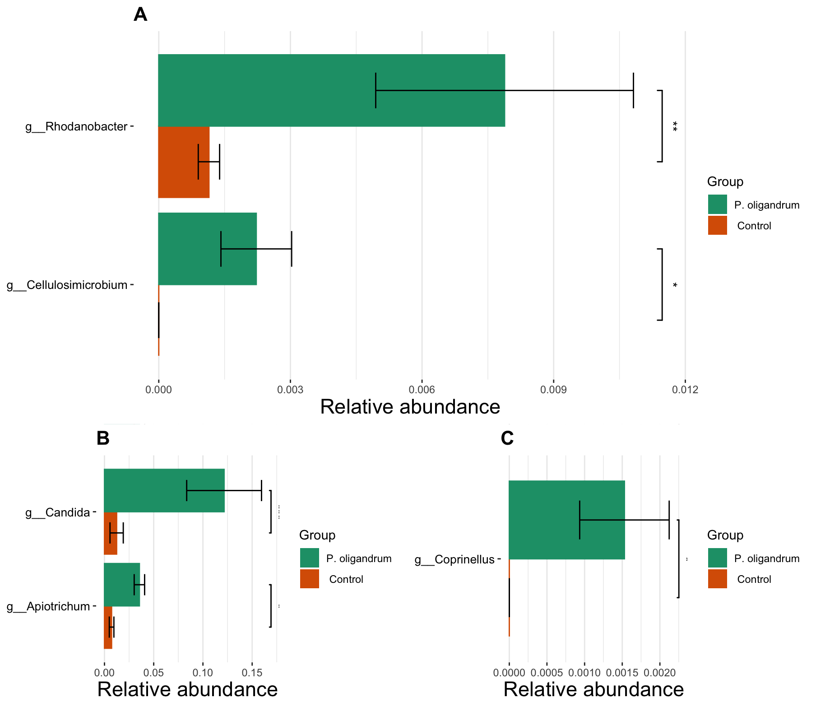
Figure 5. Differential abundance analysis of genera, between rhizosphere samples of control plants and plants treated with P. oligandrum in the rhizosphere microbiome of cv. Kuras potato plants in a small-scale field trial. (A) Bacteria differential abundant genus in August (B) Fungal differential abundant genera in August (C) Fungal differential abundant genera in September. Asterisk indicates significant differences (p < 0.05).

